Slide 1
Thirsty Thursday Mocktails
Holiday Themed Mocktails
Fall 2020

Slide 2
Holiday Mocktails
Almond Milk Chai Latte
Hazelnut Hot Chocolate
Apple Cider Floats
Crimson Holiday Punch

Slide 3
Alcohol Awareness Information
This Photo by Unknown Author is licensed under CC BY-NC-ND

Slide 4
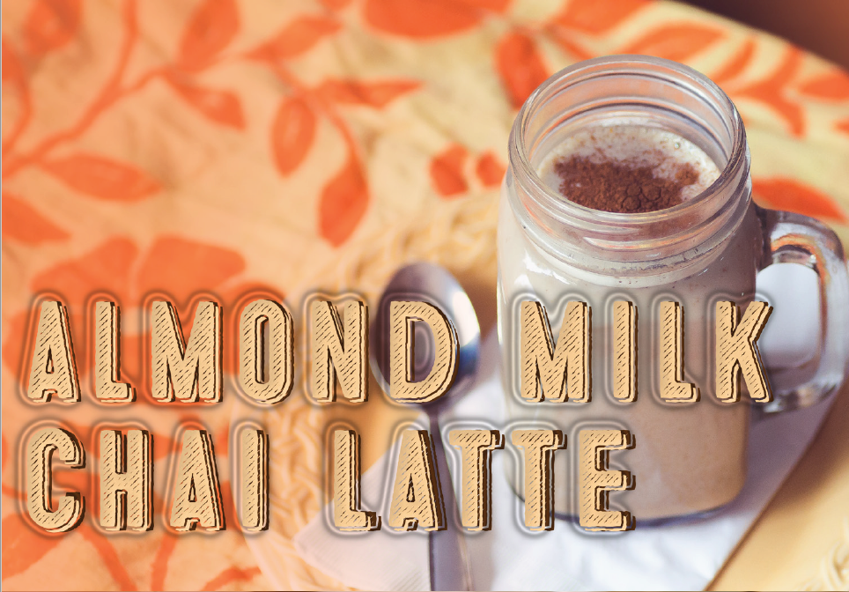
Ingredients:
2 cups almond milk, unsweetened or vanilla
2 Tbsp raw honey
½ tsp ground cinnamon
½ tsp ground ginger
½ tsp vanilla
¼ tsp ground cardamom
¼ tsp ground cloves
1 cinnamon stick
2 black tea bags

Slide 5
Gather your ingredients:

Slide 6
Directions:
Add almond milk, honey, cinnamon, ginger, vanilla, cardamom, cloves, and cinnamon stick to a small saucepan.
Heat over medium heat; stir occasionally until liquid comes to a low boil.
Remove from heat and add tea bags.
Let tea steep for 2-3 minutes.
Remove tea bags and pour.
Servings: 2

Slide 7
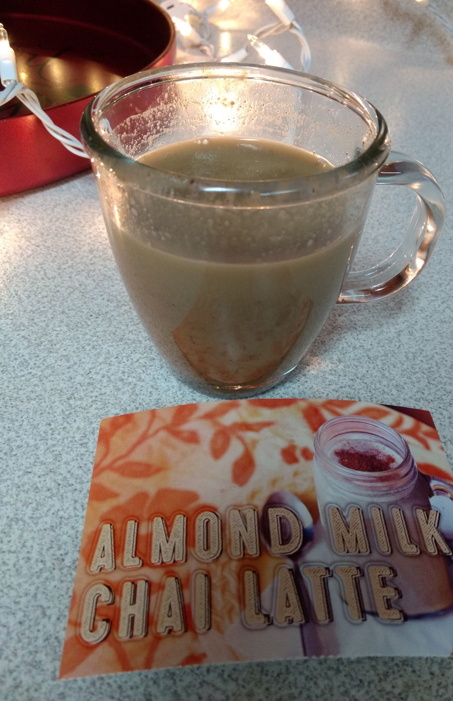
Cold-weather myth: Drinking an alcoholic beverage is the best way to stay warm on a cold day.
Facts:
Alcohol is a diuretic, which means it stimulates dehydration.
Alcohol impedes the body’s ability to regulate its own temperature.
Alcohol can slow the heart and also accelerate the harmful effects of cold body temperatures.
The more alcohol consumed, the harder it is to recognize hypothermia.

Slide 8
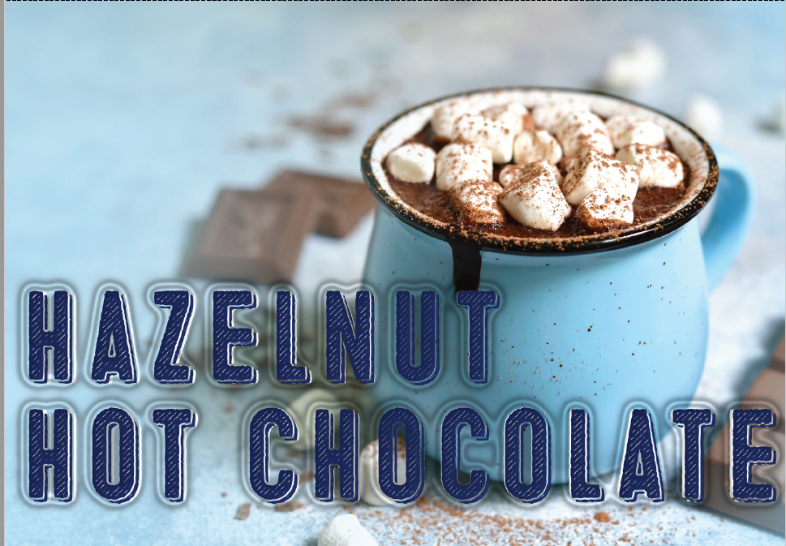
Ingredients
4 cups milk
2 Tbsp hazelnut spread
2 Tbsp unsweetened cocoa powder
2 Tbsp sugar
Marshmallows (optional)
Crushed hazelnuts (optional)
Chocolate Chips (optional)

Slide 9
Gather your ingredients:

Slide 10
Directions:
Heat milk in medium saucepan on medium high until it starts to steam.
Add the spread, cocoa powder and sugar, and whisk until dissolved and combined.
Bring to a gentle simmer while stirring and then take off heat.
Serve with desired toppings. (marshmallows, chocolate chips, crushed hazelnuts)
Servings: 4

Slide 11
Underage Drinking: Myths versus Facts
Myth: Drinking is a good way to loosen up at parties.
Fact: Drinking is a dumb way to loosen up. It can make you act foolish, say things you shouldn’t say, and do things you wouldn’t normally do. In fact, drinking can increase the likelihood of fights and sexual assaults.

Slide 12
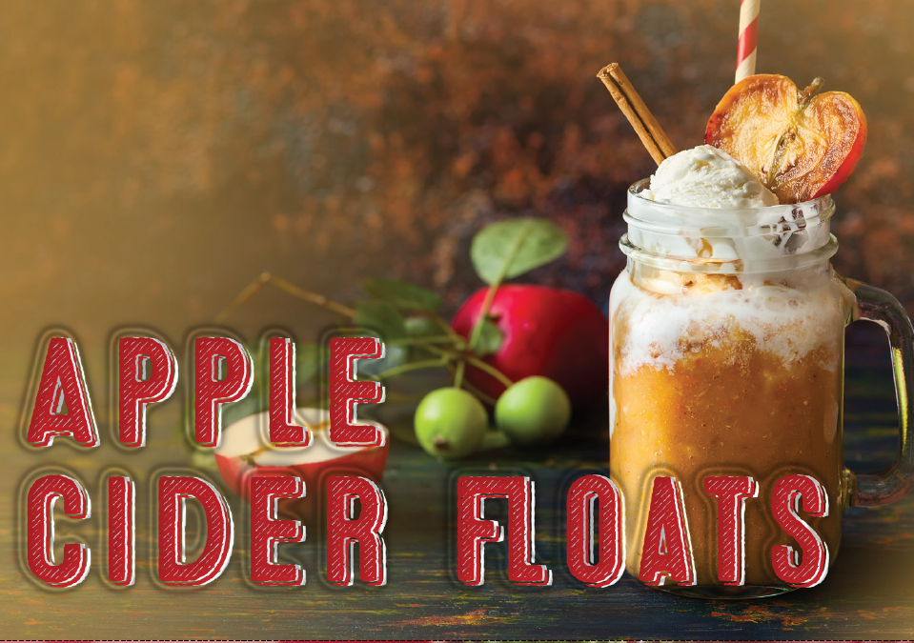
Ingredients
Sparkling apple cider
Fresh apple cider
French vanilla ice cream
Optional garnish:
Whipped cream
Apple slice
Ground cinnamon
Caramel sauce
Cinnamon stick

Slide 13
Gather your ingredients:

Slide 14
Directions
Scoop ice cream into a cup and pour equal parts sparkling apple cider and fresh apple cider.
Top with whipped cream, an apple slice, a sprinkle of ground cinnamon, a cinnamon stick and caramel sauce.
Servings: 1

Slide 15
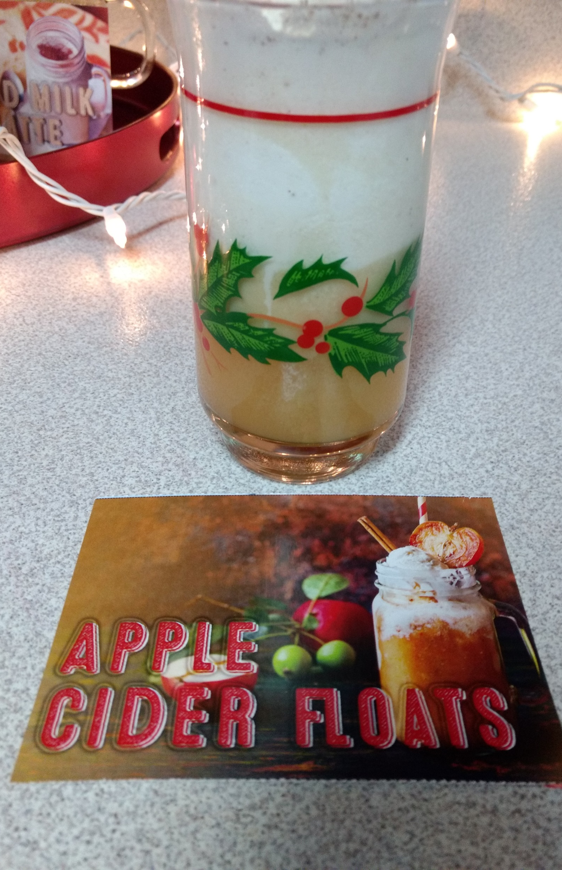
Myth: Drinking isn’t all that dangerous.
Fact:
“Many risks are associated with drinking, including impaired driving, unintentional injuries, violence, unsafe sexual behavior, suicide attempts, overdoses, and death. Even college students who don't drink may experience secondhand effects, such as disrupted study and sleep or being involved in an alcohol-related assault.”

Slide 16
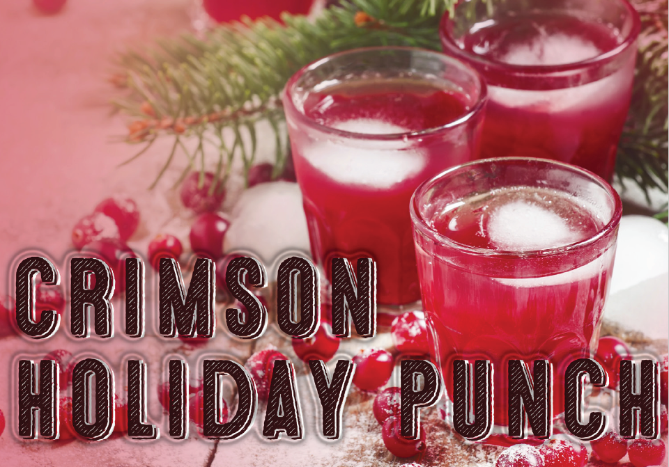
Ingredients
5 cups of tropical punch
1 cup cranberry juice
1 cup pineapple juice
½ cup lemon juice
4 to 5 cups ginger ale
1-pint raspberry sherbet

Slide 17
Gather your ingredients:

Slide 18
Directions
Make sure all ingredients are chilled.
Combine punch and all juices into a large punch bowl
Add ginger ale slowly to keep as much fizz as possible.
Add scoops of raspberry sherbet and let sit for a few minutes.
Servings: 16

Slide 19
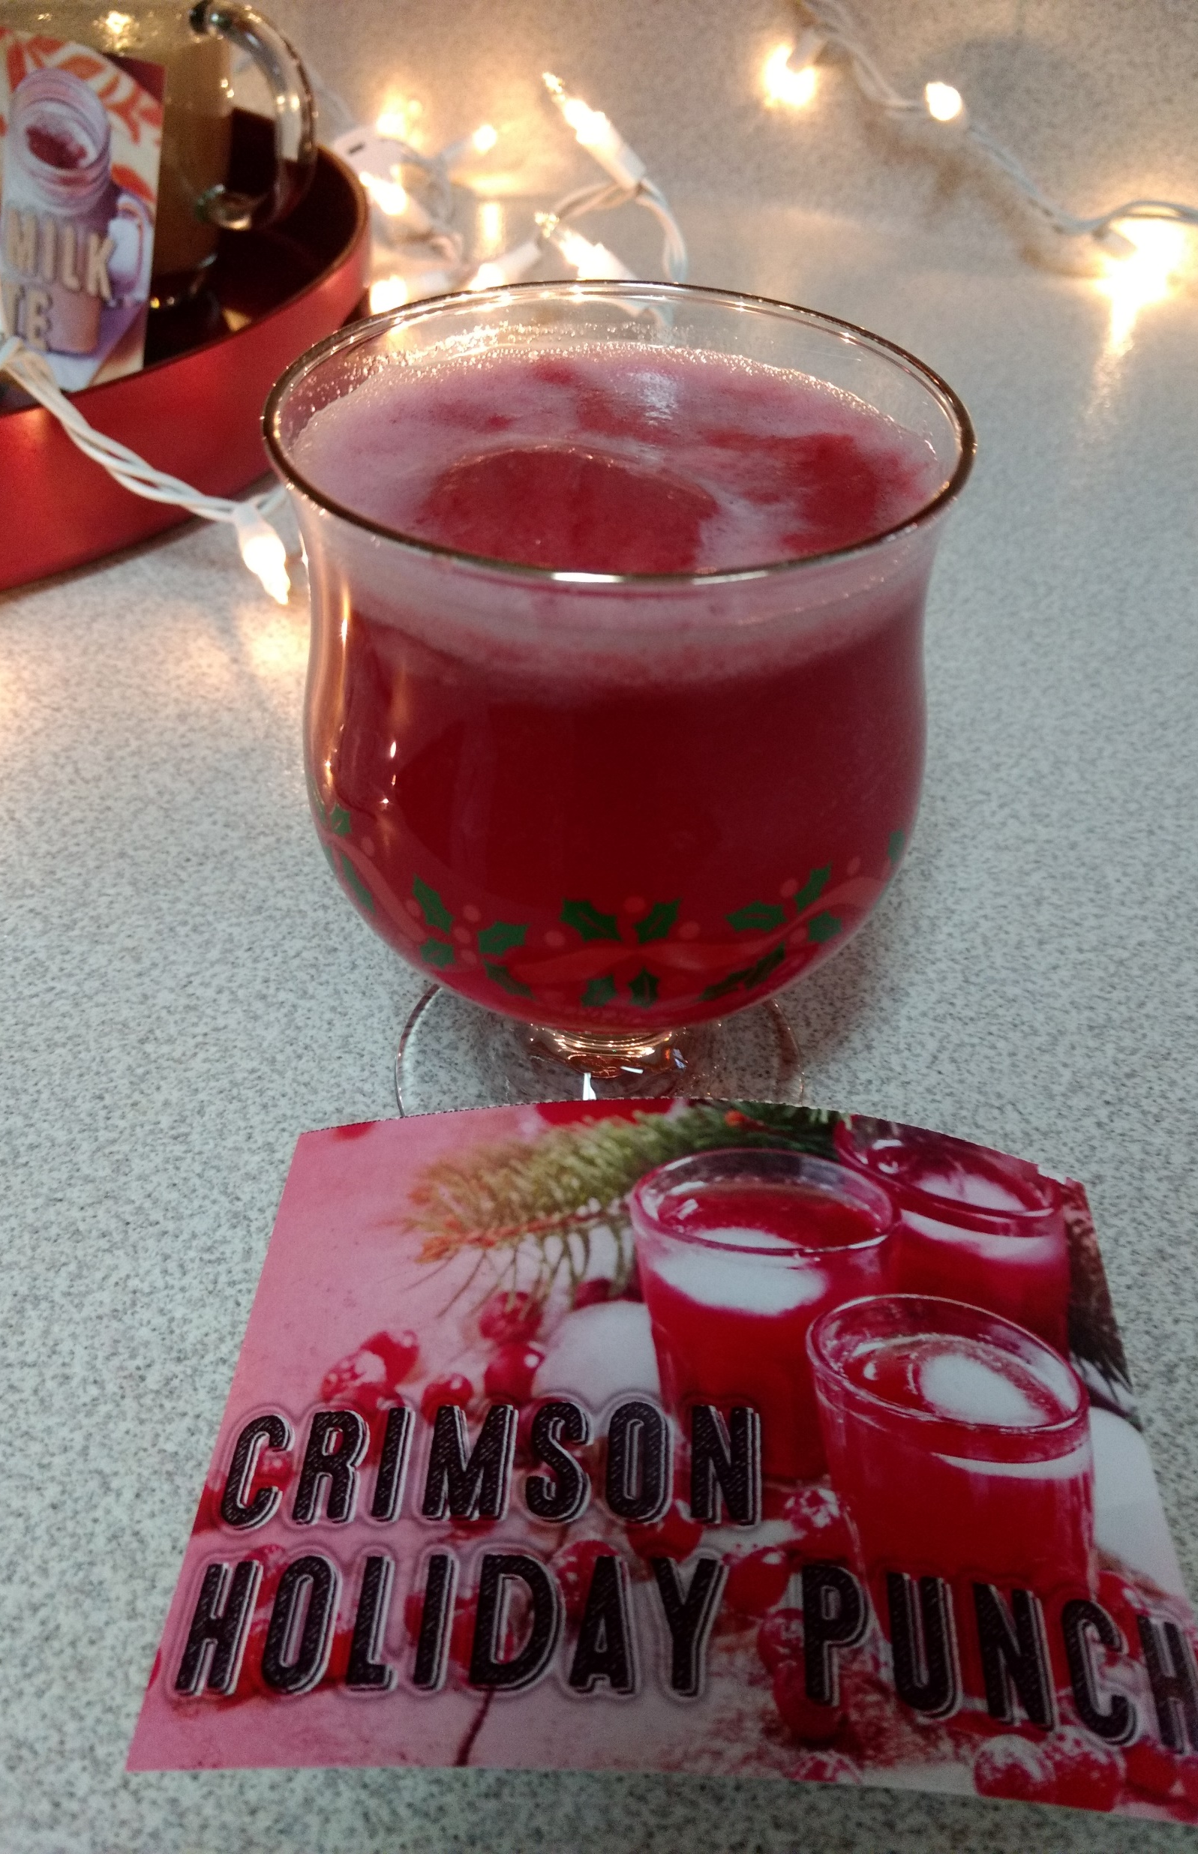
Myth: I can manage to drive well enough after a few drinks.
Fact :
“The effects of alcohol start sooner than people realize, with mild impairment (up to 0.05 blood alcohol concentration [BAC]) starting to affect speech, memory, attention, coordination, and balance. And if you are under 21, driving after drinking any amount of alcohol is illegal and you could lose your license. The risks of a fatal crash for drivers with positive BAC compared with other drivers increase as the BAC increases, and the risks increase more steeply for drivers younger than age 21 than for older drivers. Critical decision-making abilities and driving-related skills are already diminished long before a person shows physical signs of intoxication.”

Slide 20
Resources
Cold Weather Recipes
Pennsylvania Liquor Control Board Educational Resources
Substance Abuse and Mental Health Services Administration (SAMHSA)
Rethinking Drinking
College Drinking: Changing the Culture

