Slide 1
How to connect to the Pennsylvania Highlands Student Wireless
This wireless network is only available to students, faculty and staff of PHCC.

Slide 2
Student Wireless
myPHCC wireless network will ask you for username and password before you can login.
To access:
Connect to myPHCC
Open a browser screen
Enter with your username and password where prompted

Slide 3
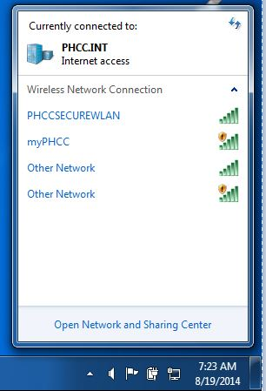
Student Wireless

Slide 4
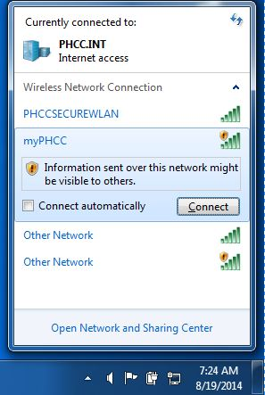
Student Wireless

Slide 5
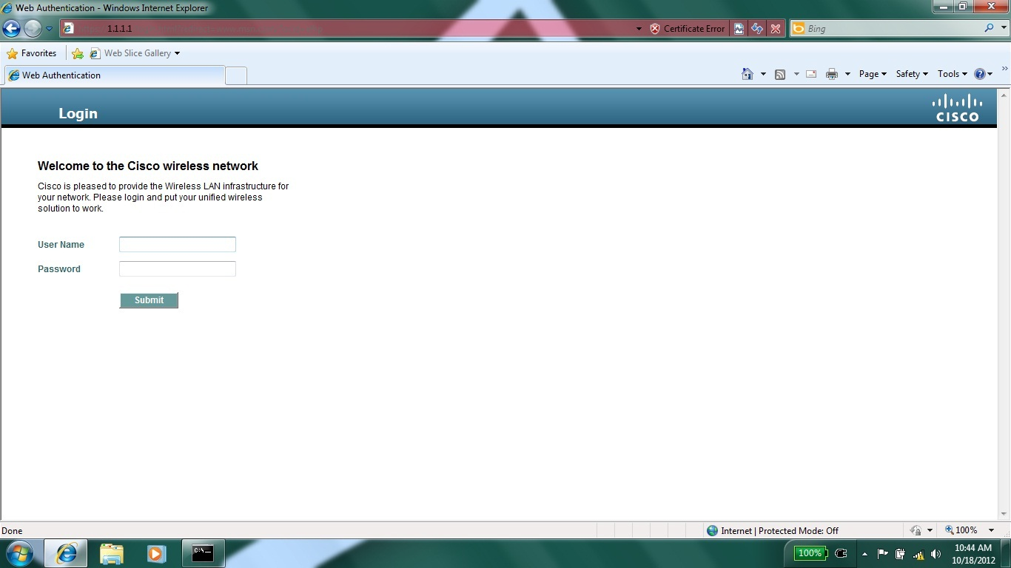
Student WIRELESS – WEB AUTHENTICATION SCREEN

