Slide 1
Office 365 Training

Slide 2
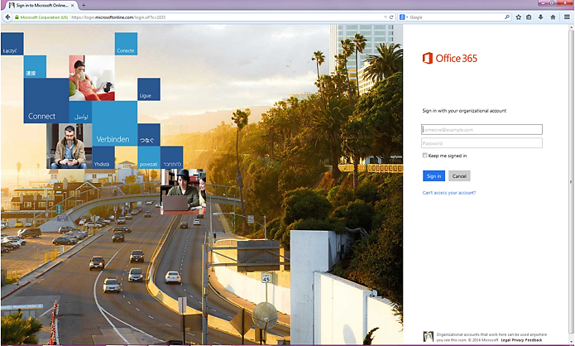
Logging In
http://login.microsoftonline.com - Login Site

Slide 3
Use your full email address (Username@pennhighlands.edu) and same password as your network credentials
You will be asked for your time zone and language with first login

Slide 4
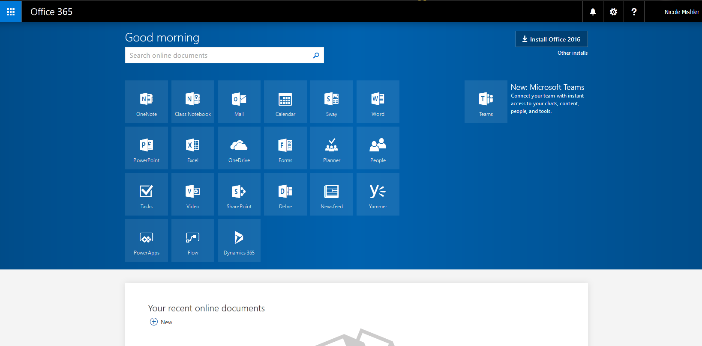
Accessing OneDrive
Your home screen will give you access to your OneDrive

Slide 5
Your OneDrive page will allow you to create new Microsoft Office documents
You can upload documents you have created from your computer
You will be able to see documents that have been shared with you.

Slide 6
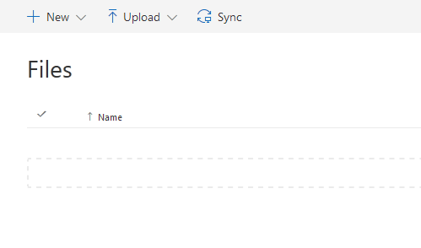
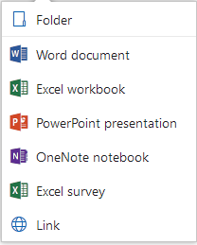
Creating a New Document
Once in your OneDrive you will see the option to create a new document and the ability to choose the type of document you would like to create

Slide 7
This will open a new blank document
The look and functionality will be similar to that of the Office version on your computer
Your documents will save automatically when returning to your home screen

Slide 8
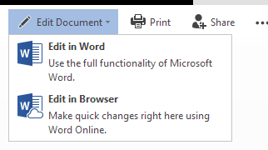
Editing Your Documents
Your OneDrive screen will show all your documents. You can easily edit the documents by clicking on them.
You will initially see the document in a read-only format. In the upper right hand corner you will need to select Edit Document and Edit in Browser

Slide 9
Your document will then open backup in an editable mode
It will still be in Office365

Slide 10
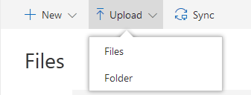
Uploading a Document
You will be able to upload your documents from your OneDrive screen
When you click on upload, it will give you the option of selecting Files or Folder for upload
This will open File Explorer and allow your to select items for upload

Slide 11
Sharing a Document
When you would like to share your document, you can open the specific document to share
In the upper right hand corner, you will see a Share option
You will need to know the email address of the person you would like to share the document

Slide 12
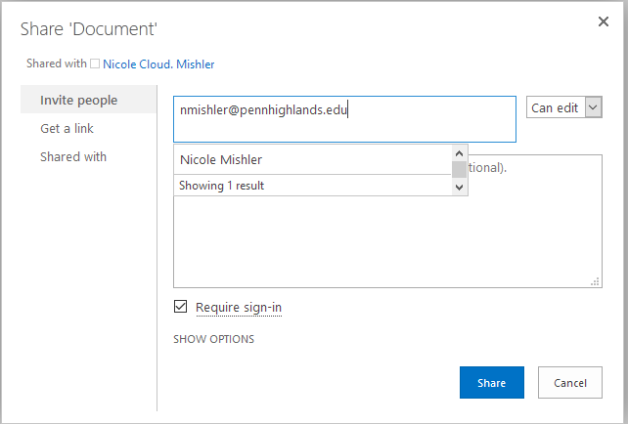
Another window will open where the email address of the recipient will be placed
Make sure the box is checked that will require the user to be logged into Office365 to see the document

Slide 13
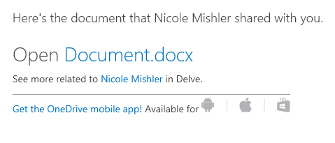
An email will be sent to the recipient with a link to the document
Once they click on the link, they will be redirected to Office365 for login and to view the document

Slide 14
Editing a Document Shared with You
When the document was shared with you, you will be the recipient of the email with the document link
You will click on the link and be redirected to Office365
The document will first be opened in the read-only mode
You will need to click on Edit Document and Edit in Browser
The document will be opened so you can now view and edit what has already been done
You will be able to see who also is editing the document and where the person is on the page

Slide 16
What You Can Do from Your OneDrive Page
By clicking on the check mark beside a file to select, you are given more options on the main page
You are easily able to share, delete, move, copy, and rename your documents
You do not have to be in the document to make these changes. This will be helpful if you want to make folders of documents

Slide 17
Security Precautions
Please do not create, upload, or share any documents that may have personal information in regards to the FERPA regulations

